Slide 1

Planning for ENERGY STAR
Reducing energy consumption to protect the environment
Civil Engineering and Architecture
© 2010 Project Lead The Way, Inc.

Slide 2
Planning for ENERGY STAR
What is ENERGY STAR?
ENERGY STAR for the Home
Components of ENERGY STAR Qualified Homes
Residential ENERGY STAR
Construction Techniques
and Products
Energy Star – Qualified Homes
ENERGY STAR and Business
Notes:
Planning for ENERGY STAR
Civil Engineering and Architecture®
Unit 2 – Lesson 2.3 – Residential Design

Slide 3
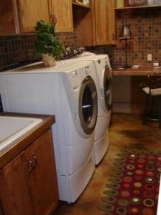
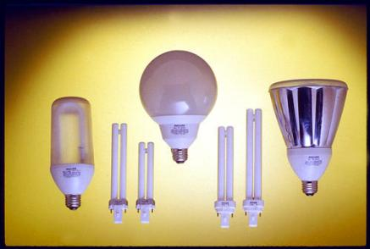
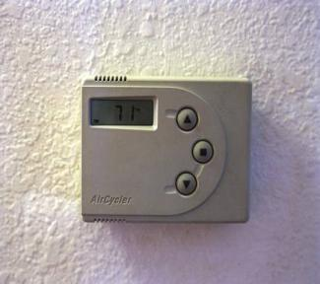
What is ENERGY STAR?
ENERGY STAR is a joint program of the U. S. Environmental Protection Agency and the U.S. Department of Energy with the goal to save consumers money and protect the environment through energy-efficient products and practices.
Notes:
Planning for ENERGY STAR
Civil Engineering and Architecture®
Unit 2 – Lesson 2.3 – Residential Design
In 2008 ENERGY STAR savings helped lower carbon dioxide emissions and saved consumers 19 billion dollars on utility bills.

Slide 4
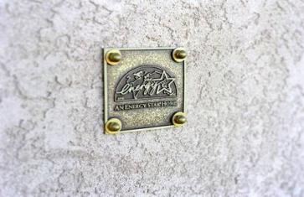
ENERGY STAR for the Home
Consumers can purchase new household products that have earned ENERGY STAR ratings.
New home buyers can purchase houses with ENERGY STAR accreditation.
Home improvements can follow guidelines and resources to reduce utility bills and reduce greenhouse gases.
Notes:
Planning for ENERGY STAR
Civil Engineering and Architecture®
Unit 2 – Lesson 2.3 – Residential Design
Without sacrificing style and comfort, ENERGY STAR can save families about a third on their energy bills and reduce greenhouse gas emissions.

Slide 5
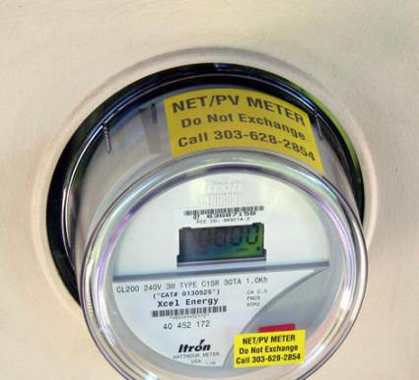
Components of ENERGY STAR Qualified Homes
Efficient Insulation
High Performance Windows
Tight Construction and Ducts
Efficient Heating and Cooling
Efficient Products
Third Party Verification
Notes:
Planning for ENERGY STAR
Civil Engineering and Architecture®
Unit 2 – Lesson 2.3 – Residential Design
The standards for home energy ratings, inspections protocols, and testing guidelines are maintained by the Residential Energy Network (RESNET). For more information, visit the RESNET Web site at www.resnet.us.

Slide 6
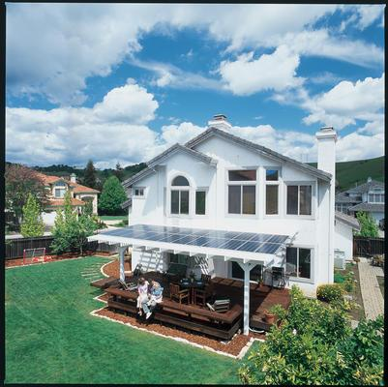
Residential ENERGY STAR
Tight Ducts
Improve indoor air quality
and comfort with less noise
Tight Construction
Eliminates drafts, moisture, dust, pests, and pollen
Improved Insulation
Blankets the home to better control temperature and noise penetration.
Energy-Efficient Heating and
Cooling Equipment
Reduces utility bills while
increasing durability
High Performance Windows
Keep the heat in during the winter
and out during the summer
Notes:
Planning for ENERGY STAR
Civil Engineering and Architecture®
Unit 2 – Lesson 2.3 – Residential Design
Efficient HVAC equipment and high performing doors help the efficiency of a home.

Slide 7
Construction Techniques and Products
Suppliers of construction materials manufacture their products with ENERGY STAR specifications. This practice allows the consumer to make decisions with the engineering already done for them.
Innovative construction methods are implemented to help reduce harm to the environment
Notes:
Planning for ENERGY STAR
Civil Engineering and Architecture®
Unit 2 – Lesson 2.3 – Residential Design

Slide 8
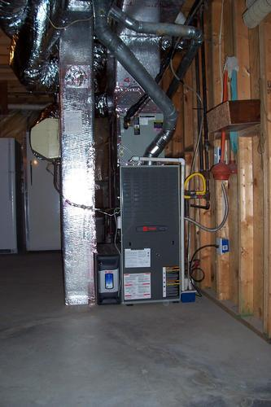
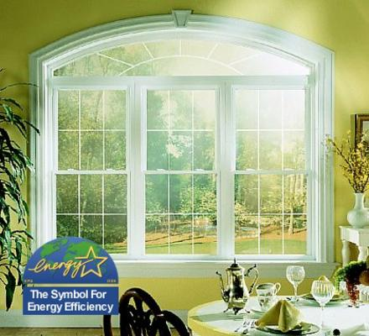
Energy Star – Qualified Homes
Energy-saving features typically make Energy Star-qualified homes 20-30% more efficient than standard homes.
Notes:
Planning for ENERGY STAR
Civil Engineering and Architecture®
Unit 2 – Lesson 2.3 – Residential Design
ENERGY STAR homes can include energy-efficient features that contribute to improve home quality and homeowner comfort, to lower energy demand, and to reduce air pollution.

Slide 9
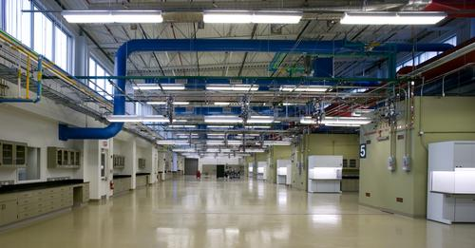
ENERGY STAR and Business
The EPA offers energy management strategies to help businesses measure energy performance by setting goals, tracking savings, and rewarding improvements.
80,000 buildings in the U.S. use the ENERGY STAR system.
The EPA recognizes top performing buildings with ENERGY STAR awards.
Notes:
Planning for ENERGY STAR
Civil Engineering and Architecture®
Unit 2 – Lesson 2.3 – Residential Design

Slide 10
Planning for ENERGY STAR
What is ENERGY STAR?
ENERGY STAR for the Home
Components of ENERGY STAR Qualified Homes
Residential ENERGY STAR
Construction Techniques
and Products
Energy Star – Qualified Homes
ENERGY STAR and Business
Notes:
Planning for ENERGY STAR
Civil Engineering and Architecture®
Unit 2 – Lesson 2.3 – Residential Design

Slide 11
Image Resources
Microsoft, Inc. (2009). Clip Art. Retrieved April 7, 2009, from http://office.microsoft.com/en-us/clipart/default.aspx
Notes:
Planning for ENERGY STAR
Civil Engineering and Architecture®
Unit 2 – Lesson 2.3 – Residential Design

